Slide 1

THE POWER OF RECON
OrwaGodfahter

Slide 2

ABOUT ME
Orwa Atyat (OrwaGodfather) from Jordan
Full time bug hunter
(Starting bug bounty 2020)
Bugcrowd P1 Warrior Rank: Top 3
500+ critical/high bug submitted
HOF: Meta / Google / Microsoft / Apple
Hack Cup Winner 2022/2023 & Team Captain
10+ 0Days/CVEs

Slide 3
Microsoft IIS Testing
Response Manipulation
Methods &Tips

Slide 4
IIS
screenshot
screenshot
screenshot
screenshot
screenshot
Microsoft IIS tilde directory enumeration
this vulnerability allow to detect short names of files and directories in IIS app by using some vectors in several versions of Microsoft IIS.
as an attacker can find important files and folders that they are not normally visible.
Next parts in IIS
Discovering , Tools , Wordlist for fuzzing , Testing , Tips
Last part in IIS
Example for critical bugs…..

Slide 5
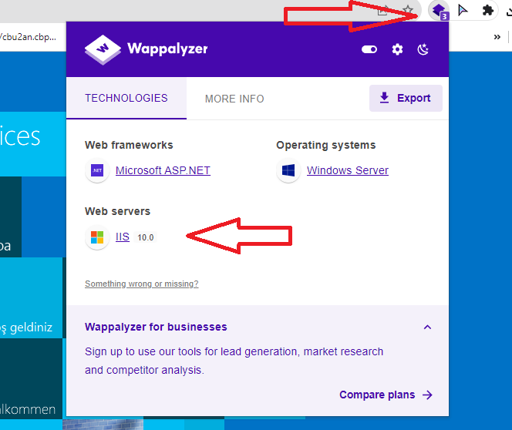
IIS
screenshot
screenshot
screenshot
screenshot
screenshot
Discovering
Nuclei Template
nuclei-templates/fuzzing/iis-shortname.yaml
https://github.com/projectdiscovery/nucleitemplates/blob/d6636f9169920d3ccefc692bc1a6136e2deb9205/fuzzing/iis-shortname.yaml
2) Wappalyzer extenstion

Slide 6
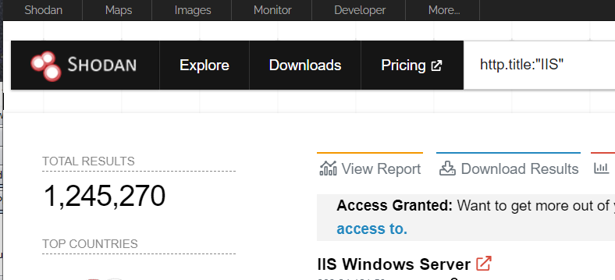
IIS
screenshot
screenshot
screenshot
screenshot
screenshot
Discovering
3) Shodan 🡺 http.title:"IIS"
Company dork
Ssl:"Bsides Ahmedabad Inc." http.title:"IIS"
Host dork
Ssl.cert.subject.CN:"bsidesahmedabad.in" http.title:"IIS"

Slide 7
IIS
Tools For Testing
IIS Tilde Enumeration (Burp Extension)
2) Shortscan tool Github
[to detect short names of files and directories]
3) JetBrains dotPeek
[to analyze files such as dll file and export the source of that file]
4) visual studio code
[for read/review the code/source]

Slide 8
IIS
5) ffuf
Web directory brute forcer
Wordlist
https://github.com/orwagodfather/WordList/blob/main/iis.txt
Its can be used on vulnerable and normal IIS app
Its can be used on other web apps

Slide 9
IIS
Testing
Sortscan basic usage
$ shortscan https://url/
Burp Extension IIS Tilde Enumeration
Copy the target url and scan
**NOTE** any valid dir endpoint such as 403,401,301,200 etc… scan that endpoint again , not just the url

Slide 10
IIS
Testing
example
$ shortscan https://bsidesahmedabad.in/
$ shortscan https://bsidesahmedabad.in/admin/
$ shortscan https://bsidesahmedabad.in/test/
FFUF fuzzing
$ ffuf -w iis.txt -u https://bsidesahmedabad.in/FUZZ
$ ffuf -w iis.txt -u https://bsidesahmedabad.in/shortnameFUZZ
Shortname-FUZZ / shortname_FUZZ

Slide 11
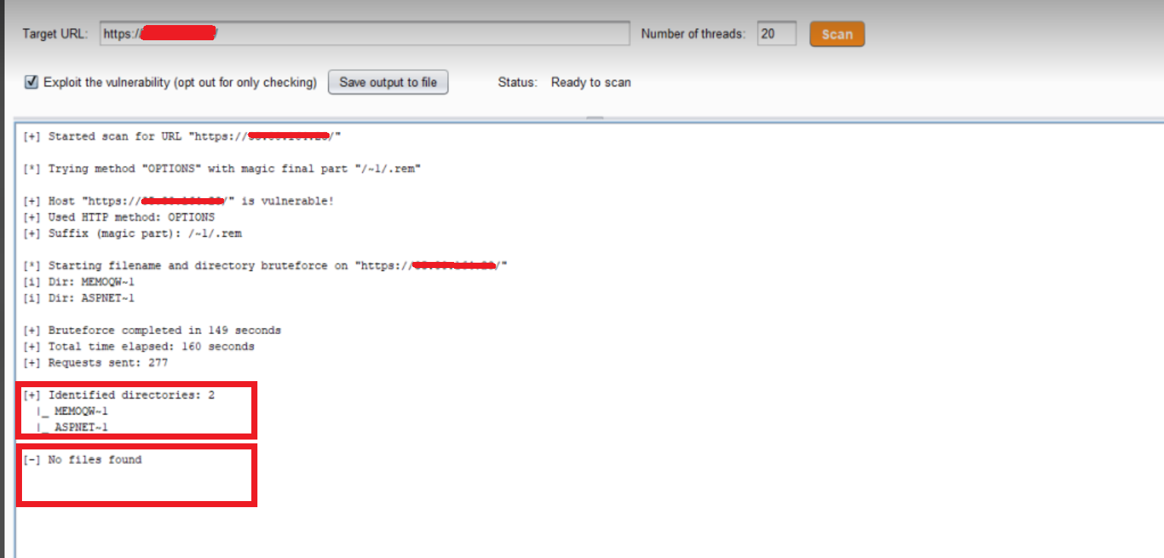
IIS

Slide 12
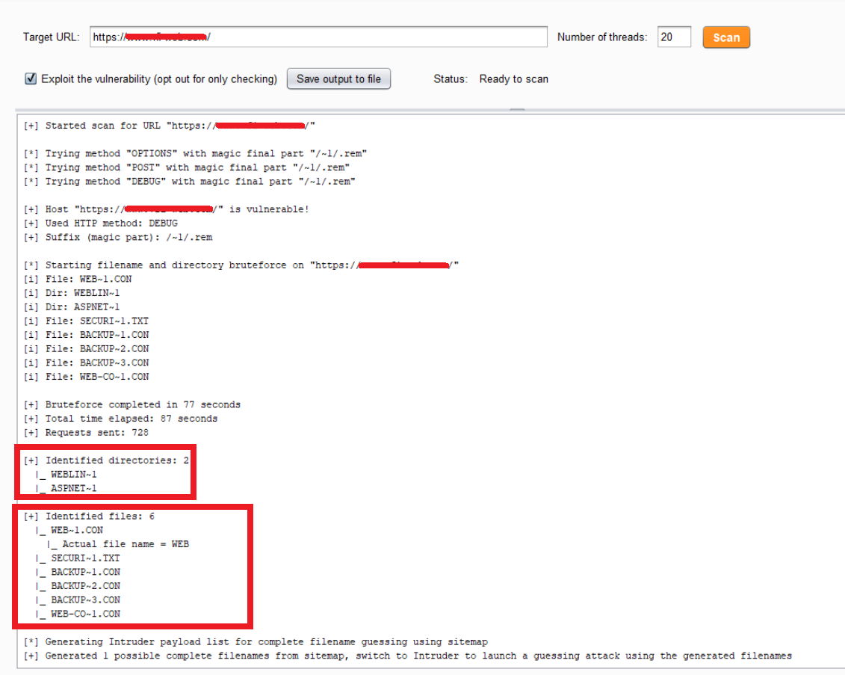
IIS

Slide 13
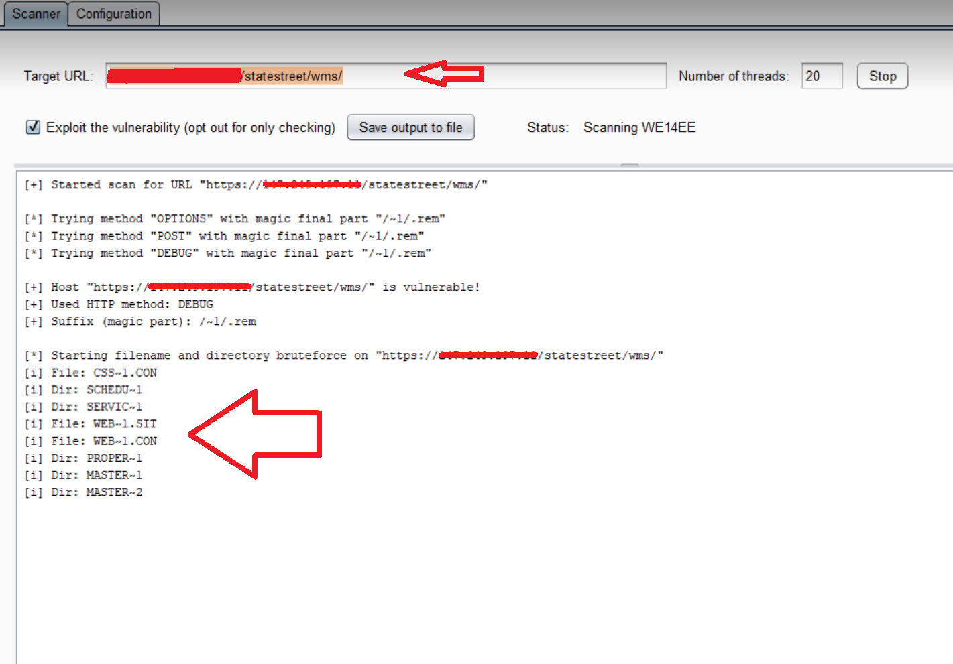
IIS

Slide 14
IIS
Tips to complete the shortname and get a valid Dir/file
https://IIS/
[+] Identified directories: 1
|_ DS_STO~1
Identified files: 1
|_ DESKTOP~1.ZIP
FFUF
$ ffuf -w iis.txt -u https://IIS/ds_stoFUZZ
$ ffuf -w iis.txt -u https://IIS/desktopFUZZ.zip
$ ffuf -w iis.txt -u https://IIS/desktop-FUZZ.zip
$ ffuf -w iis.txt -u https://IIS/desktop_FUZZ.zip
$ ffuf -w iis.txt -u https://IIS/desktop%20FUZZ.zip

Slide 15
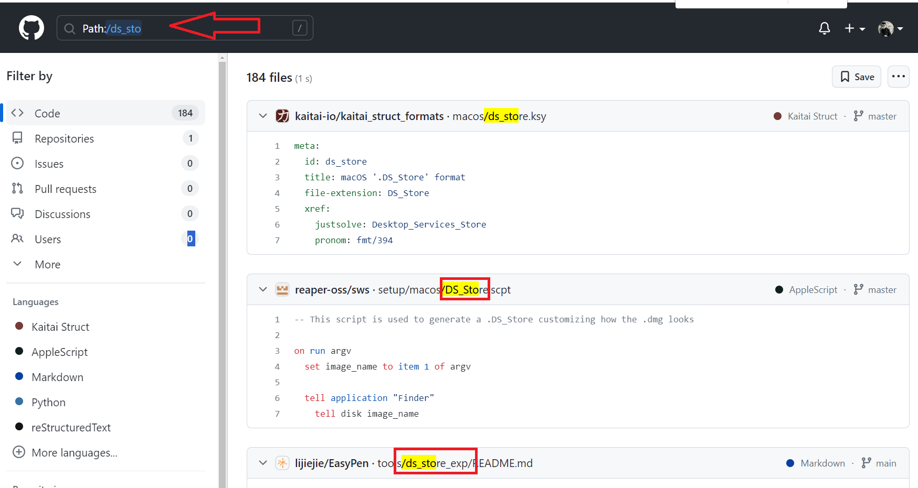
IIS
Tips to complete the shortname and get a valid Dir/file
2) Github dorking
Path:/ds_sto

Slide 16
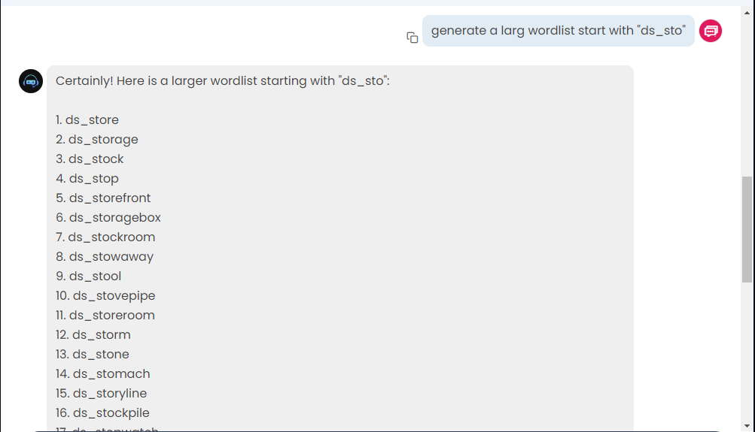
IIS
Tips to complete the shortname and get a valid Dir/file
3) Chat AI

Slide 17
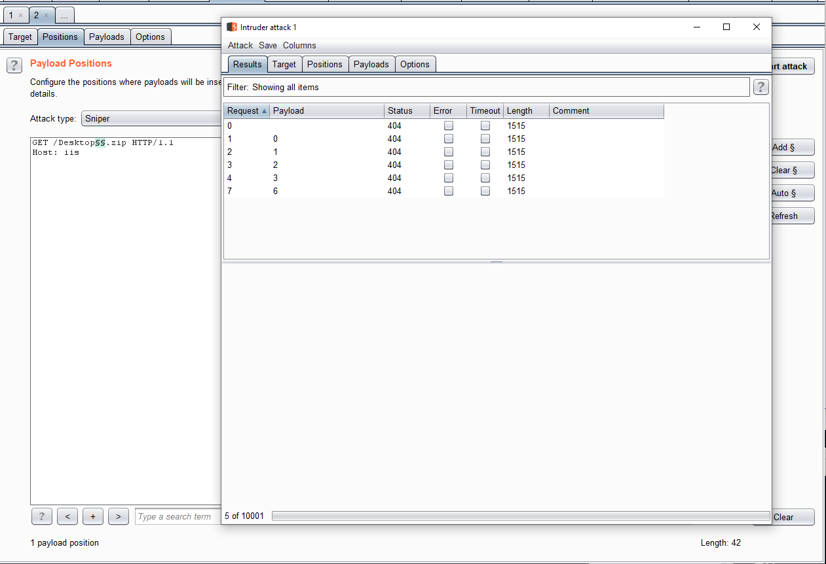
IIS
Tips to complete the shortname and get a valid Dir/file
4) Intruder (numbers 0-100000)/Etc….

Slide 18
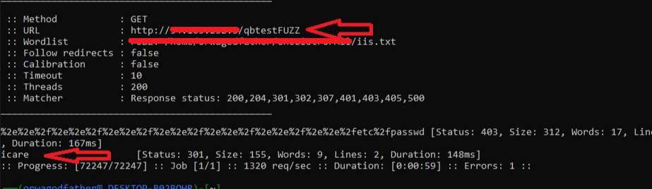
IIS
Dir: QBTEST~1 🡺 after fuzzing I found a valid endpoint redirect to test login QBTESTicare

Slide 19
IIS
Example for critical bugs…
1 full source backup
|_ admin~1.ZIP 🡺 with previous tips found admin_backup.zip
what i got ???
* credentials in source file
* machine key
* valid unauth upload endpoint 🡺 uploaded a shell to RCE

Slide 20
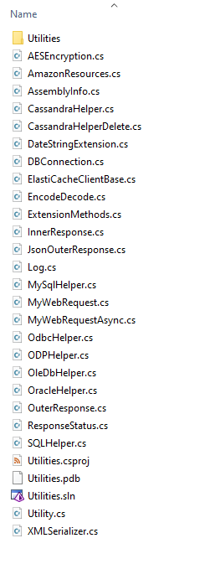
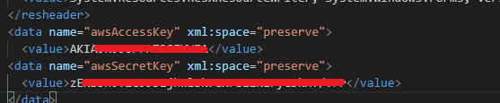
IIS
Example for critical bugs…
3) DLL file 🡺 export source 🡺 Access to AWS credentials
File: UTILIT~1.DLL 🡺 UTILITies.dll 🡺 send it to JetBrains dotPeek exported the project 🡺 start code review

Slide 21
IIS
and there's a more and more and more..... references
https://learn.microsoft.com/en-us/previous-versions/aspnet/2wawkw1c(v=vs.100)
https://book.hacktricks.xyz/pentesting-web/deserialization/exploiting-__viewstate-knowing-the-secret
https://github.com/bitquark/shortscan
https://twitter.com/ctbbpodcast/status/1688607912434819073
https://www.youtube.com/watch?v=HrJW6Y9kHC4
https://www.youtube.com/watch?v=cqM-MdPkaWo
https://www.youtube.com/watch?v=HU89u0rQXf4

Slide 22
RESPONSE MANIPULATION
Authentication Bypass
Permissions: Edit , ADD , Del etc..
Prices & Currency

Slide 23
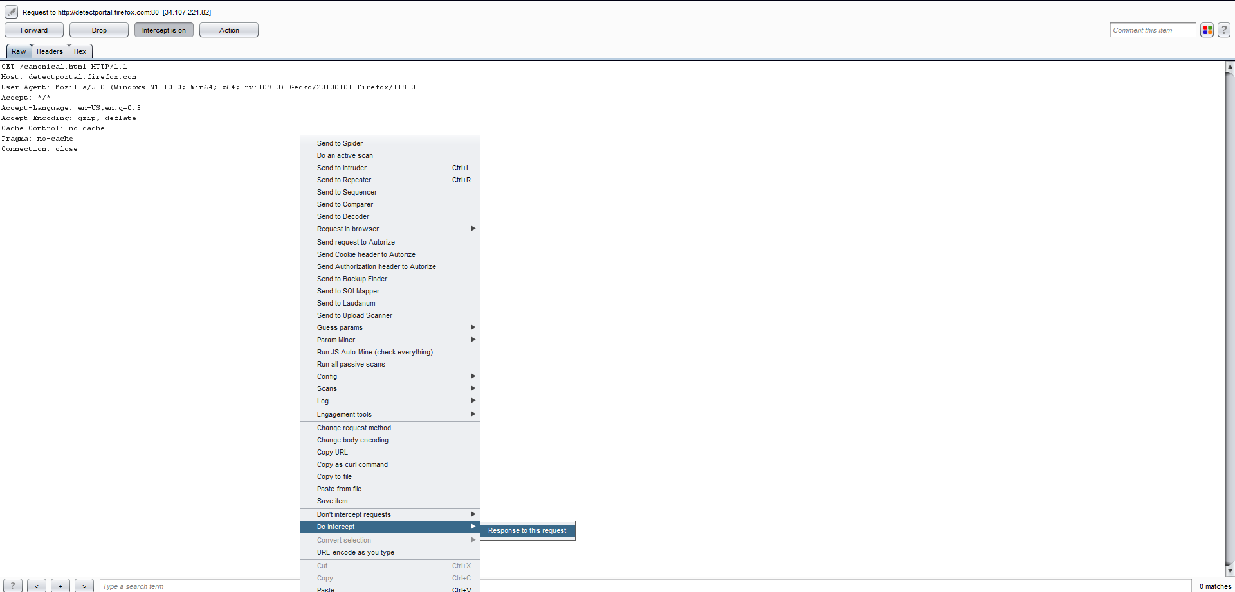
RESPONSE MANIPULATION

Slide 24
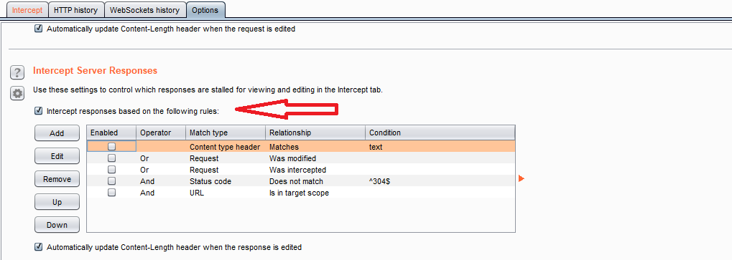
RESPONSE MANIPULATION

Slide 25
RESPONSE MANIPULATION
Authentication Bypass examples…
Login page response
HTTP/1.1 302 Found
Location: ../login/?redirect=//location/?5
Replacement content
Deleted header Location: ../login/?redirect=//location/?5
HTTP/1.1 200 OK
Match And Replace type: response header match : HTTP/1.1 302 Found replace: HTTP/1.1 200 ok
Match And Replace type: response header match : Location: ../login/?redirect=//location/?5 replace:
Standard login 🡺 302 login page redirection with large Content-Length
Bypassed authentication using Burp Suite Match And Replace.
Tip: If the response is 302 with a big Content-Length try to bypass it

Slide 26
RESPONSE MANIPULATION
Authentication Bypass examples…
Request
POST /Account/Login HTTP/1.1
Host: XXXX
{"username":"bsides","password":"orwaBsides"}
Tip: 1 replace [400 bad request] to [200 ok]
2 replace [false] to [true]
its can be done via match and replace
Response
HTTP/1.1 400 Bad Request
Connection: close
Content-Type: xxxxx
Server: xxxxx
false

Slide 27
RESPONSE MANIPULATION
Authentication Bypass examples…
Create account in the employee login panel
Replaced the registration value
Created an employee account and retrieved login panel privileges
Response
{"registration ":false,"Etc………
Replaced contents
{"registration ":true,"Etc………

Slide 28
RESPONSE MANIPULATION
Permissions examples…
Normal Response
"login_permission":user,"
"Admin":false, "
{"permissions":["can_read"]}
{"status":"0"}
{"status":"failure"}
Replaced Response
"login_permission":admin,"
"Admin":true, "
{"permissions":["can_read","can_write"]}
{"status":"1"}
{"status":"success"}

Slide 29
RESPONSE MANIPULATION
Prices & Currency examples…
Normal Response
"code":"USD,","baseAmount":99.10,"
Replaced Responses
"code":"USD,","baseAmount":10.99,“
"code":"USD,","baseAmount":0.99,"
"code":"USD,","baseAmount":9.10,"
"code":"INR,","baseAmount":99.10,“
"code":“EUR,","baseAmount":99.10,"

Slide 30
METHODS &TIPS
1) Bypass waf using origin IP via match & replace in burp
2) My method about get more sub domains via amass
3) My method about discovering more domains & 3rd party’s & endpoints

Slide 31
METHODS &TIPS
1) Bypass waf using origin IP via match & replace in burp
best resources to find origin IPs
shodan.io 🡺 Ssl.cert.subject.CN:"domain/subdomain"
en.fofa.info 🡺 normal search for domain/subdomain
search.censys.io 🡺 normal search for domain/subdomain
securitytrails.com 🡺 normal search for domain/subdomain

Slide 32
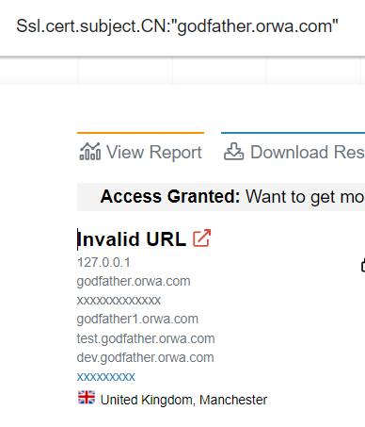
METHODS &TIPS
any ip can be use as origin IP for this tip as example [400 bad request IP]
Example for Origin IP from shodan Ssl.cert.subject.CN:"godfather.orwa.com"
godfather.orwa.com 🡺 200 / Waf
127.0.0.1 🡺 400 bad request
===>

Slide 33
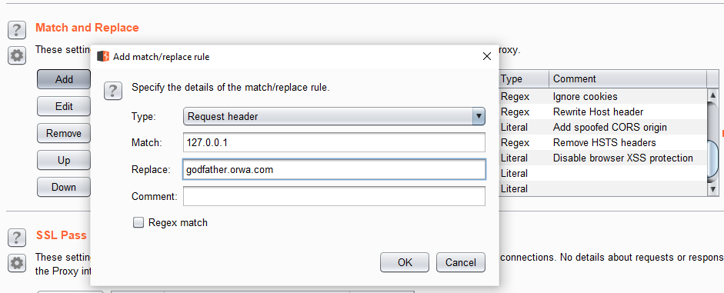
METHODS &TIPS
Match & Replace
Type: Request header
Match: Origin IP Replace: Waf host
Now when you visit the origin IP 🡺 https://ip/ the response 200
you will have access to host app without waf

Slide 34
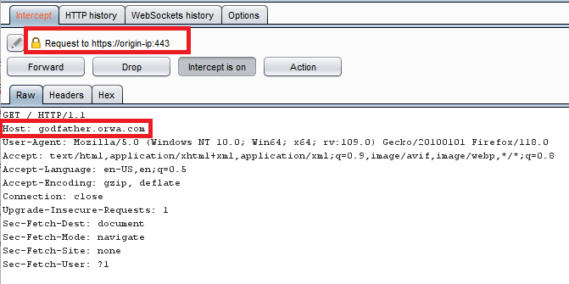
METHODS &TIPS

Slide 35
METHODS &TIPS
2) My method about get more sub domains via amass
* Add API Keys / Credentials to amass config file /home/.config/amass/
* 2 steps to run amass ….
Step 1
amass enum -passive -norecursive -noalts -d bsidesahmedabad.in -o sudomins.txt
Step 2
amass enum -passive -norecursive -noalts -df sudomins.txt -o more-subdomains.txt
testing on Ex appcheck 🡺 normal 230 sub 🡺 step 1 259 sub 🡺 step 2 326 sub

Slide 36
METHODS &TIPS
3) My method about discovering more domains & 3rd party’s & endpoints
Urlscan.io/search
Ex. bsidesahmedabad.in keywords bsidesahmedabad.* / bsidesahmedabad-*
Remove duplicate results
Ex. [bsides.* -bsidesahmedabad.in]
Ex. [bsidesahmedabad.* -bsidesahmedabad.in]
Ex. [bsidesahmedabad.in -www.bsidesahmedabad.in -help.bsidesahmedabad.in]

Slide 37
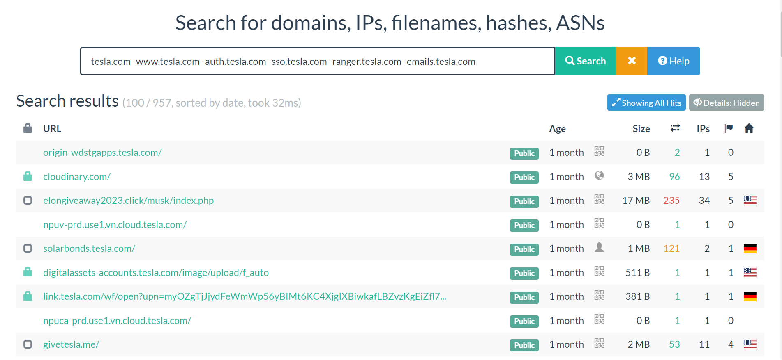
METHODS &TIPS EX:

Slide 38
METHODS &TIPS
bing & google dorking
keywords site:domain.com
Remove duplicate results
-site:duplicate.domain.com
Ex.
site:bsidesahmedabad.in -site:supprot.bsidesahmedabad.in

Slide 39
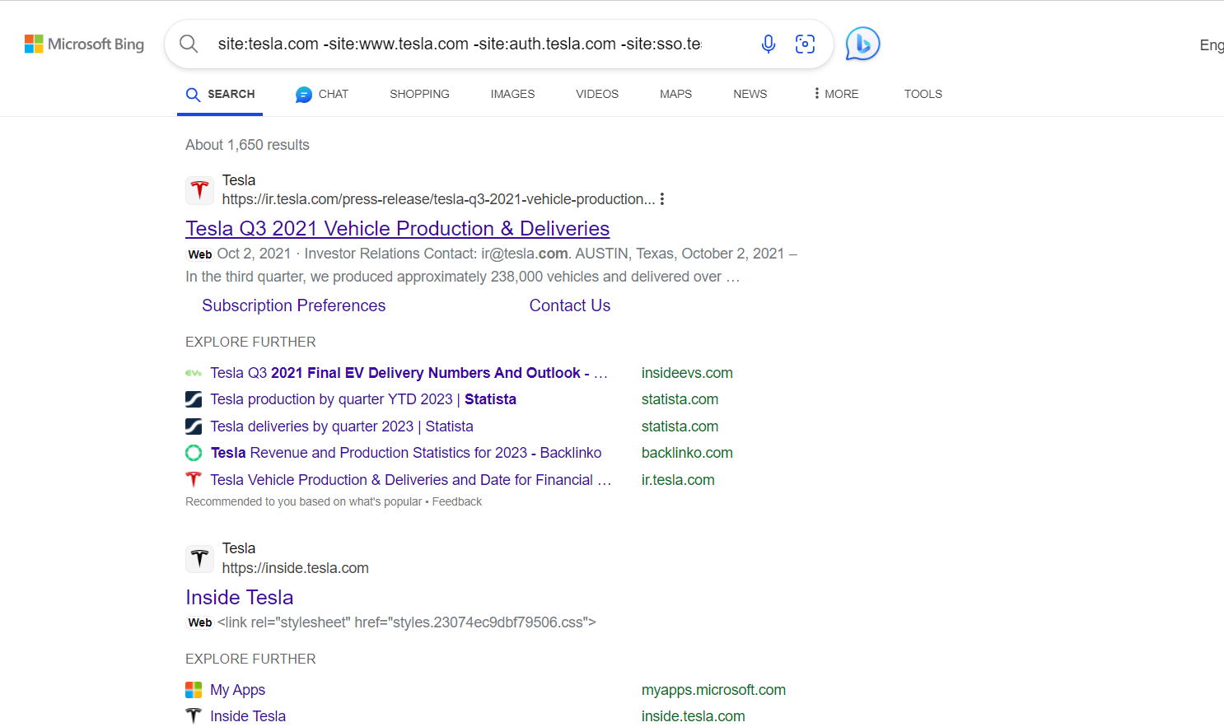
METHODS &TIPS EX:

Slide 40
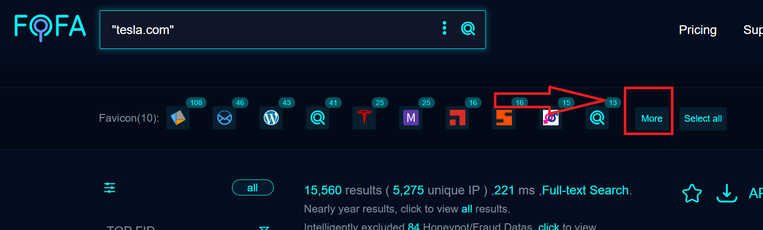
METHODS &TIPS
Mixing Fofa & Shodan search engines
Getting Favicon hash from fofa

Slide 41
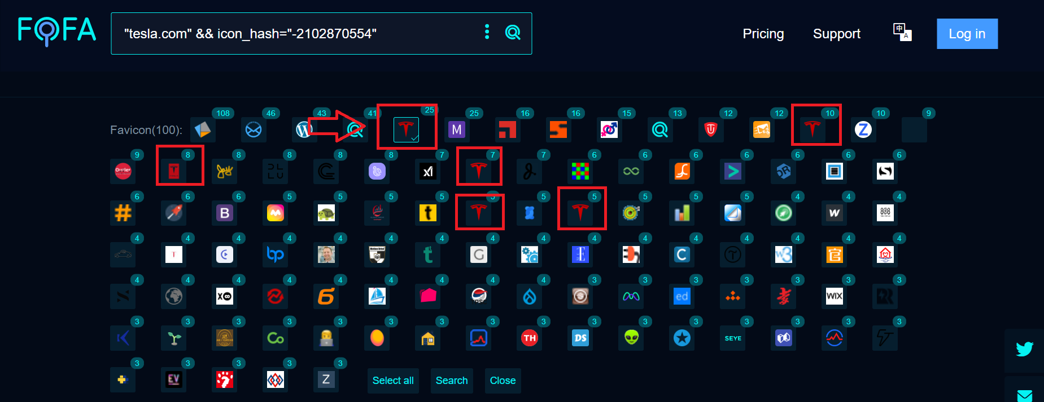
METHODS &TIPS

Slide 42
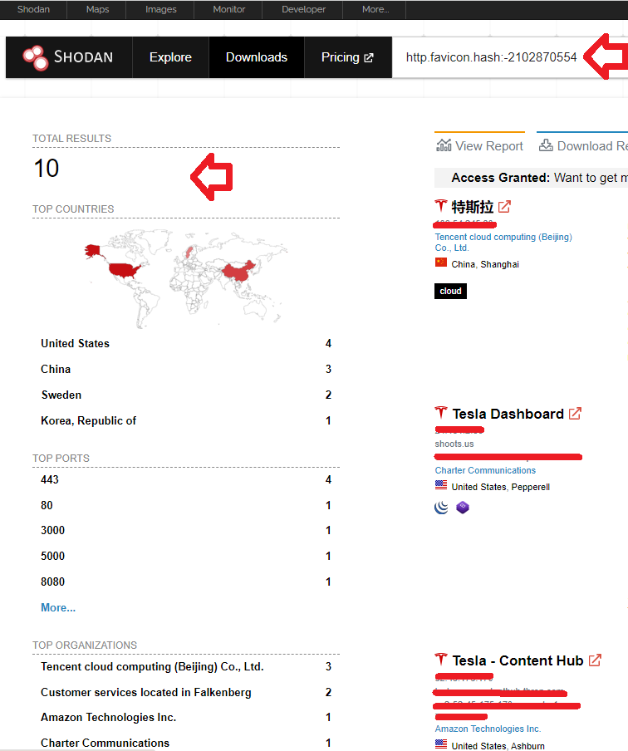
METHODS &TIPS
Favicon hash form fofa it can be used on shodan via dork
http.favicon.hash:xxxxxxxxxx

Slide 43
METHODS &TIPS
Favicon hash help customers to locate the spam/fake/phishing hosts….
References for more tips for dorking in sohdan and for finding more endpoints
The Power Of Shodan
https://www.youtube.com/watch?v=WgMGLlpznao

Slide 44
METHODS &TIPS
Endpoints Tool (Waymore)
https://github.com/xnl-h4ck3r/waymore
Wayback Machine (web.archive.org)
Common Crawl (index.commoncrawl.org)
Alien Vault OTX (otx.alienvault.com)
URLScan (urlscan.io)

Slide 45
METHODS &TIPS
checking endpoints manually is more useful
EX:
host.com/xxx/xxxx/xxx.zi [.zip]
host.com/xxx/xxxx/xxx.p [php/pdf] host.com/xxx/xxxx/xxx.ex [exe]

Slide 46
THANK YOU
https://twitter.com/godfatherorwa
https://bugcrowd.com/orwagodfather
https://hackerone.com/mr-hakhak

